Slide 1
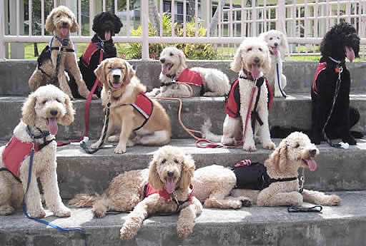
Barking Up the Right Tree: Navigating Accomodation Requests for Animals on College Campuses
Kris Caudle, Legal Fellow for the Office of Legal Affairs
Gena Smith, Director of Disability Services

Slide 2
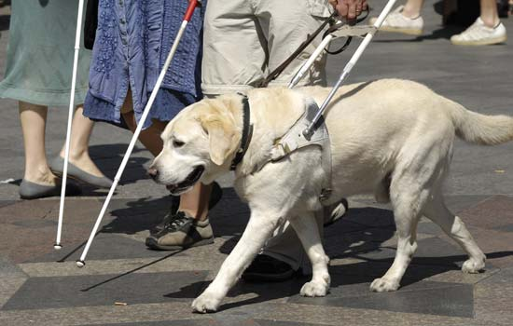
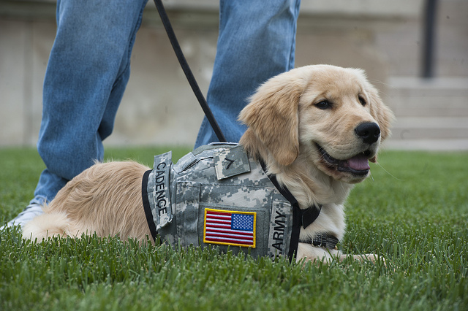

Slide 4
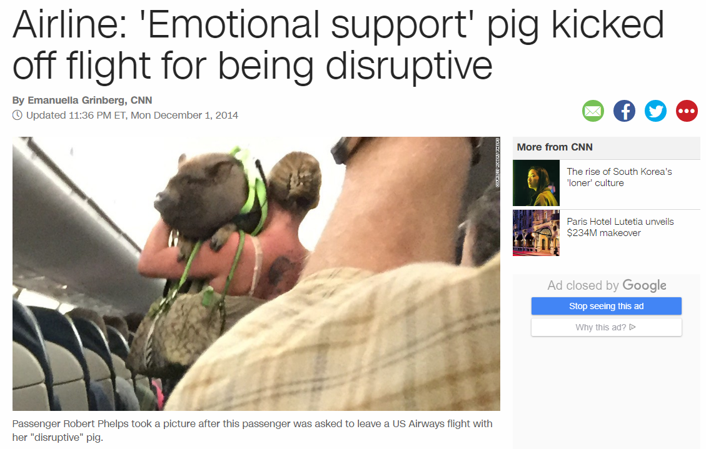

Slide 5
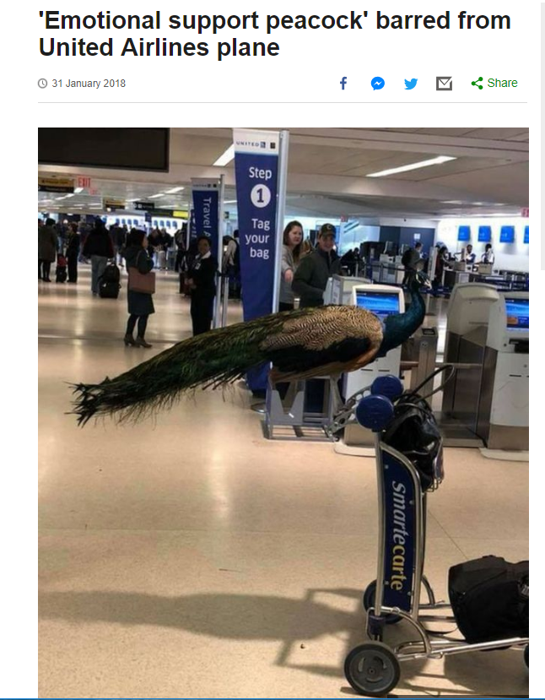
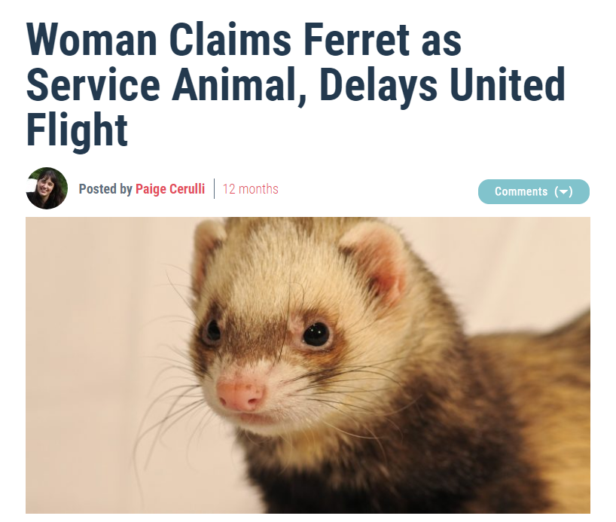

Slide 6
Today’s Agenda
Review UP 704
Relevant Federal Laws
“Service Animal” vs. “Assistance Animal”
Hypos
Questions

Slide 7
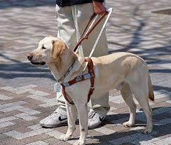
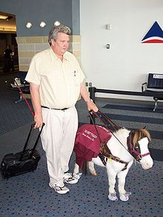
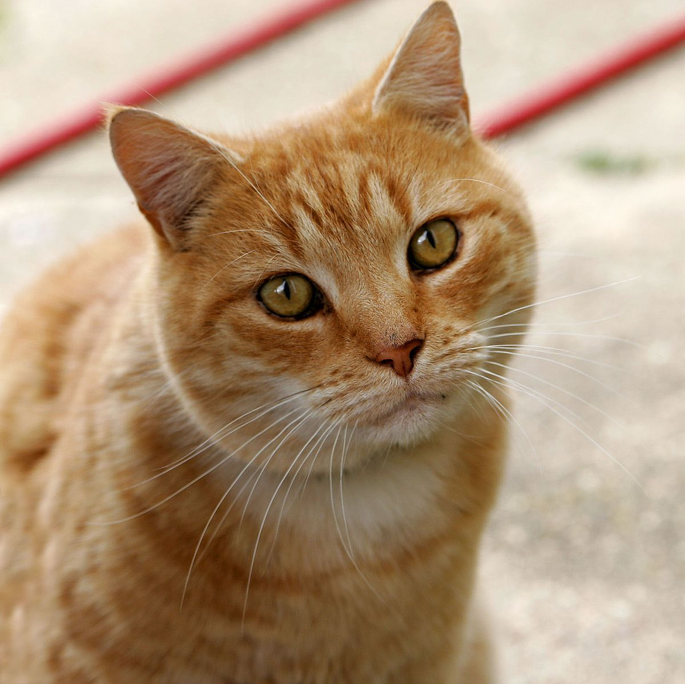
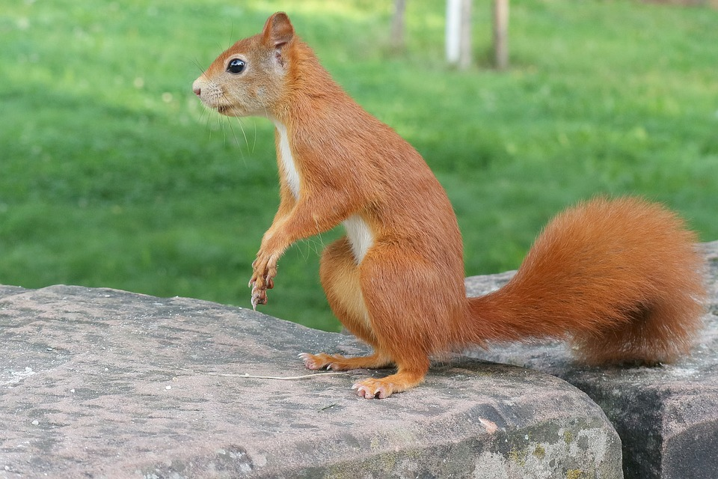
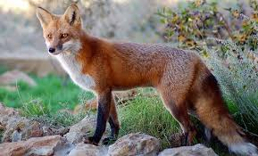
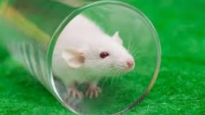
UP 704: Animals on Campus
Service Animal/Service Animal in Training
Domestic Animals
Feral or Wild Animals
Laboratory Animals Used for Teaching and Research
Emotional Support Animals

Slide 8
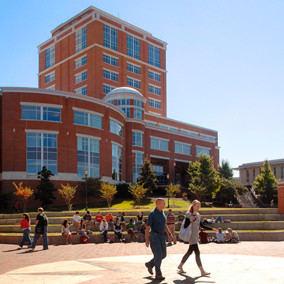
UP 704: Animals on Campus
UP 704 applies to all animals on campus
Basic Requirements for all animals:
Control
Vaccination
University reserves the right to remove any animal that is:
Is a direct threat to health and safety of any member of the campus community or to any other animal;
Disruptive; or
Not housebroken

Slide 9
Federal Disability Laws

Slide 10
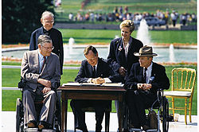
Americans with Disabilities Act (1990)
No qualified individual with a disability shall be excluded from participation in or be denied the benefits of services, programs, or activities of a public entity, or be subjected to discrimination by a public entity.
University must provide a reasonable accommodation to a person with a disability unless providing the request would impose an undue burden or fundamentally alter an education program.
Notes:
UNC-Charlotte is a public entity, applies to students and employees with disabilities.
Employees and students have to ask us for a reasonable accmodation. Accomodation form that describes the limitations to do the essential functions of their job or for students to access their education.
Tell University what accomodations they need.

Slide 11
Service Animals
“Any dog that is individually trained to do work or perform tasks for the benefit of an individual with a disability, including a physical, sensory, psychiatric, intellectual or mental disability.”
The work or tasks performed by a service animal must be directly related to the individual’s disability.
Other species of animals (e.g. wild or domestic, trained or untrained) are NOT service animals.
Notes:
Task is something that helps you complete something in your everyday life, not comfort from the presence of the animal. A task would be a dog that is trained to sense the onset of a seizure and alert another person. A task is a dog that is trained to open doors for a blind person, or calm a person down when they are having a panic attack.
No requirement that a person with a disability register their service animal with the University. Students can go to ODS and tell Gena Smith that they have a service animal and that it will be coming onto campus and we can send an accomodation letter to faculty letting them know that the service animal will be present in the class.
The accomodation letter just states that this is a service animal and that it is trained to do work for a person with a disability.

Slide 12
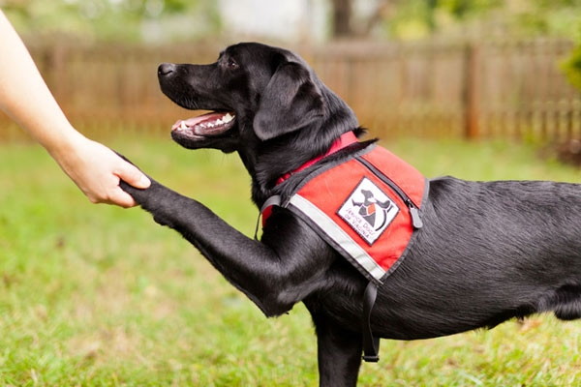
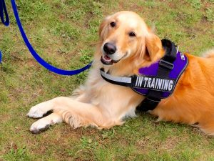
Service Animals in Training
N.C.G.S. 168-4.2
A Service Animal in Training is an animal training to become a Service Animal
The animal must be accompanied by the person who is training the Service Animal and the animal must be wearing a collar, leash, harness or cape that identifies the animal as a Service Animal in Training
Notes:
Every person with a disability has the right to be accompanied by a service animal trained to assist the person with his or her specific disability in any of the places listed in G.S. 168-3, and has the right to keep the service animal on any premises the person leases, rents, or uses. The person qualifies for these rights upon the showing of a tag, issued by the Department of Health and Human Services, under G.S. 168-4.3, stamped "NORTH CAROLINA SERVICE ANIMAL PERMANENT REGISTRATION" and stamped with a registration number, or upon a showing that the animal is being trained or has been trained as a service animal. The service animal may accompany a person in any of the places listed in G.S. 168-3.
N.C.G.S. 168-4.5- Misdemeanor under North Carolina law for a person to disguise an animal as a service animal or a service animal in training.

Slide 13
N.C.G.S. 168-4.2:
An animal in training to become a service animal may be taken into any of the places listed in G.S. 168-3 for the purpose of training when the animal is accompanied by a person who is training the service animal and the animal wears a collar and leash, harness, or cape that identifies the animal as a service animal in training.
The trainer is liable for any damage caused by the animal.

Slide 14
Service Animals (cont’d)
University officials may only ask the following two questions as it relates to the presence of a service animal on campus:
Is the service animal required because of a disability?
What work or task(s) has the service animal been trained to perform?
Notes:
Can’t ask them what their disability is. Can’t ask them for documentation on the disability or the training that the animal has received
What you can do is listen to their answers. They may share quite a bit of information. If the answer to #1 or #2 reflects on this being just an emotional support animal and that it hasn’t received any training, then it isn’t a service animal.

Slide 15
Hypo #1
George is a junior at UNC-Charlotte and very active in intramural soccer. During the spring semester, George experienced a seizure in his chemistry lecture and was admitted into the hospital for treatment. Over the summer George was diagnosed with a seizure disorder by his primary care doctor.

Slide 16
Hypo #1
For the Fall semester, George decided to bring a service animal named Pete to campus. Pete has been trained to calm humans experiencing panic attacks but George believes Pete can also be trained to detect seizures too. George wants to bring Pete to campus as a Service Animal in Training until October, when the next training class begins. George also requests that Pete be present on the sidelines at his intramural soccer games, which begin the second week of September.

Slide 17
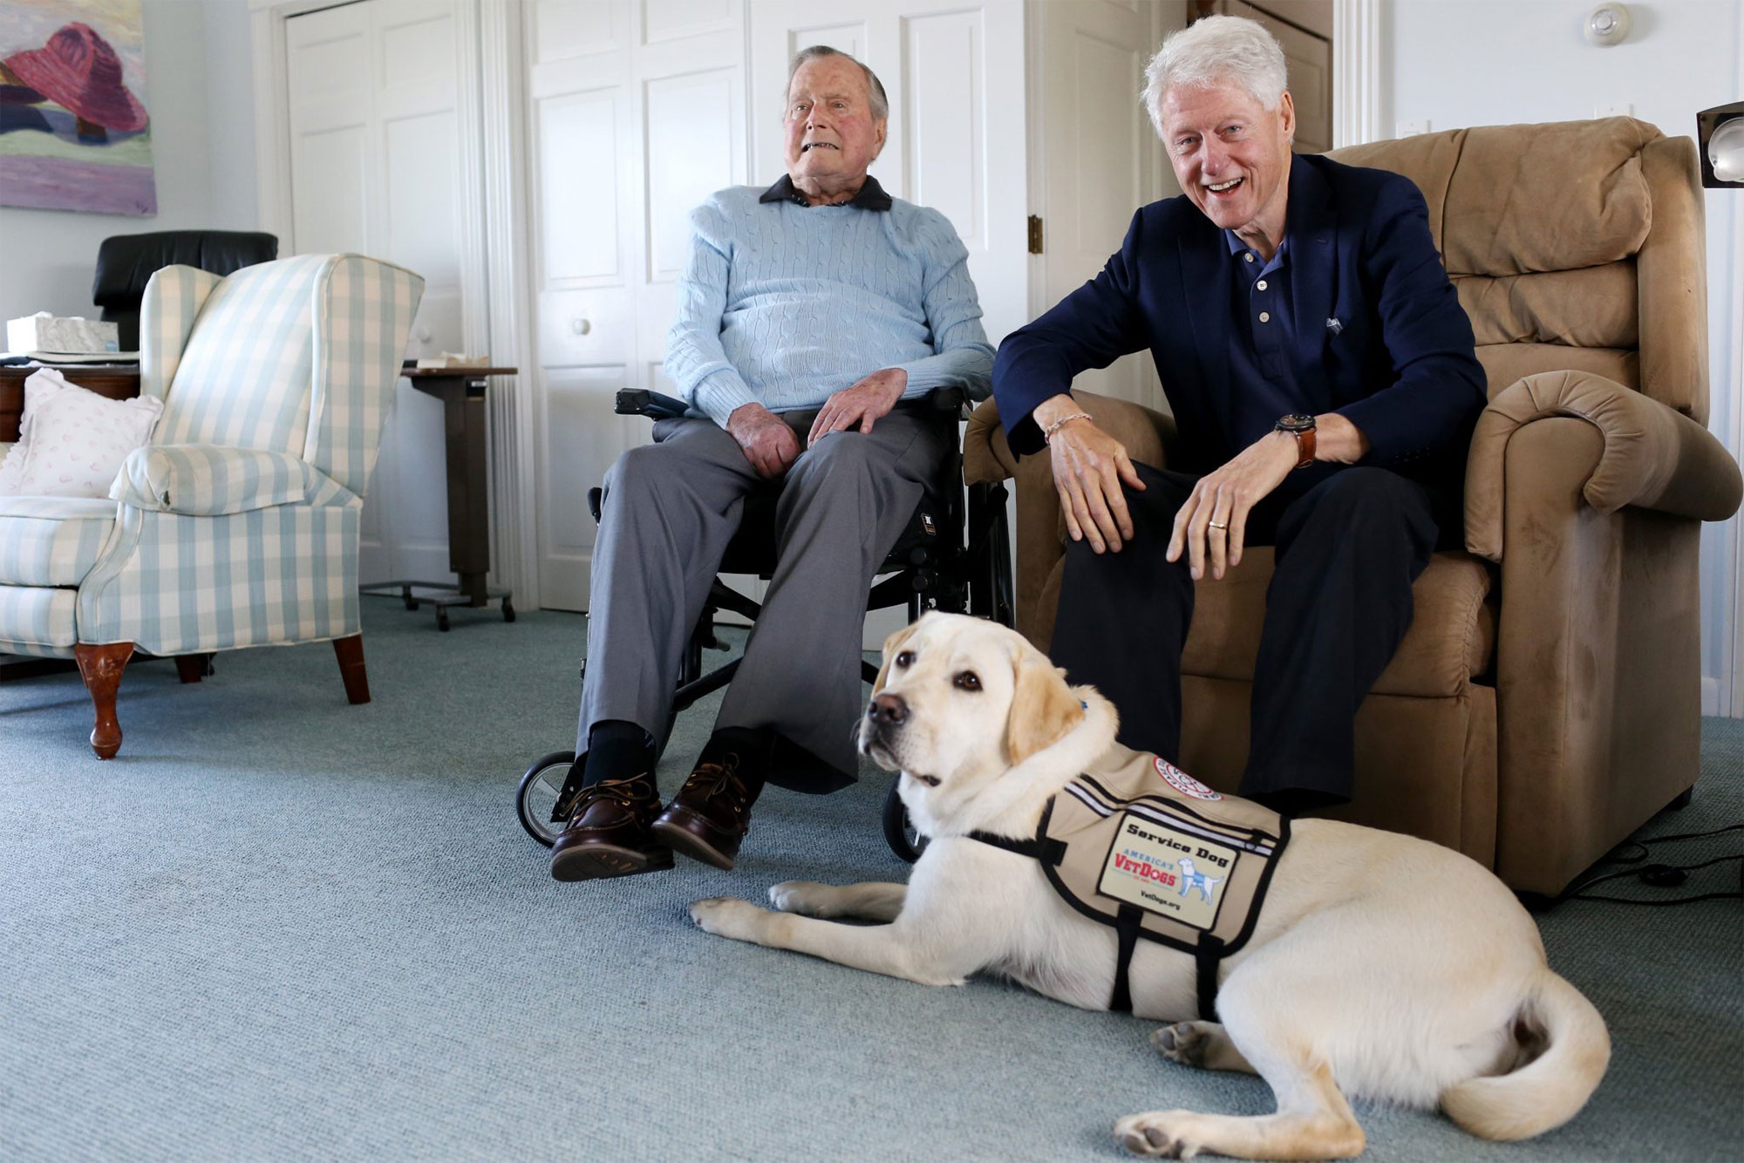

Slide 18
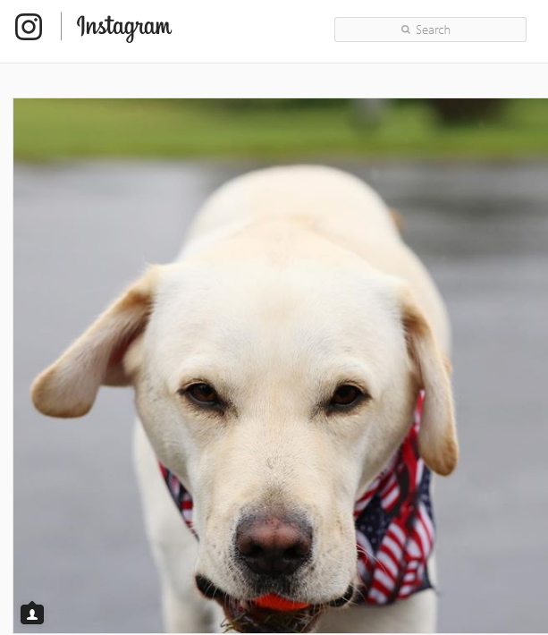
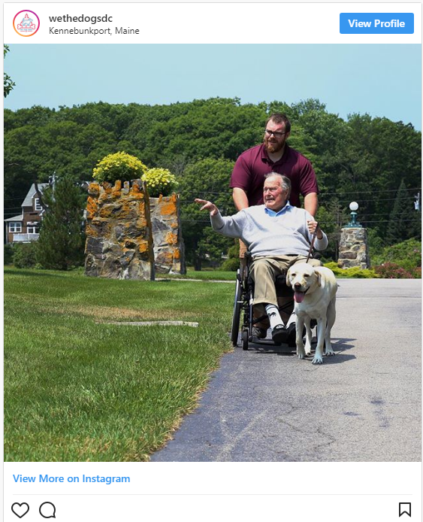

Slide 19
Assistance Animals

Slide 20
Assistance Animals
Therapy Animal
Emotional Support
Animal

Slide 21
Assistance Animals
The Fair Housing Act (FHA) prohibits discrimination on the basis of disability in housing.
Under FHA, it is unlawful to “refuse to make a reasonable accommodation in rules or policies, practices, or services” when it would be necessary to afford a person an equal opportunity to “use and enjoy a dwelling.”
Enforced by the Department of Justice (DOJ) and the Department of Housing and Urban Development (HUD)
Provide a reasonable accommodation unless doing so would amount to an undue burden for the educational institution.

Slide 22
Assistance Animals (cont’d)
2013 HUD guidance related to “assistance animals” states:
“Any animal that:
works, provides assistance, or performs tasks for the benefit of a person with a disability, or
provides emotional support that alleviates 1 or more identified symptoms or effects of a person’s disability.
HUD guidance does not require that an assistance animal be individually trained or certified.
But: Universities can require that students present medical documentation showing how the assistance animal alleviates a symptom of a person’s disability.

Slide 23
Accomodation Analysis for Assistance Animals

Slide 24
Accomdoation Analysis
HUD guidance requires that institutions of higher education permit students to have assistance animals in their “dwellings” if:
The person has a disability;
The animal is necessary to afford the person with a disability an equal opportunity to use and enjoy the dwelling; and
Identifiable relationship or nexus between the disability and the assistance that the assistance animal provides.
Notes:
Educational institutions must conduct an individualized assessment.
Assessment must be based on objective evidence about the specific animal, not fear, speculation, or generalized notations of a particular animal based on breed or weight

Slide 25
U.S. v. The University of Neb. at Kearney (2013)
A UNK student was diagnosed with depression and anxiety. The student’s doctor prescribed a service animal that was trained to respond to her anxiety attacks.
The student signed a lease to live in a University apartment and requested to have her dog live with her in the apartment.
The University had in place a “no-pets” policy and denied the student’s request.
U.S. DOJ, on behalf of the student, brought a lawsuit against UNK alleging that it’s failure to provide an accommodation was a violation of the FHA.
University argued that on-campus housing was not a “dwelling” within the meaning of FHA.
Summary judgment (in part) for the plaintiff (student) holding that housing facilities on UNK’s campus were “dwellings” within the meaning of FHA.

Slide 26
Accomodation Analysis (cont’d)
Exceptions:
Undue financal or adminstrative burden
Accomodation fundamentally alters the essential nature of housing service
Direct threat to the health and safety of others that cannot be reduced or eliminated by another reasonable accommodation
Substantial physical damage to property
Animal is out of control
Animal is too large in relation to space
Animal violates another person’s right to peace and quiet enjoyment
Animal is not vaccinated

Slide 27
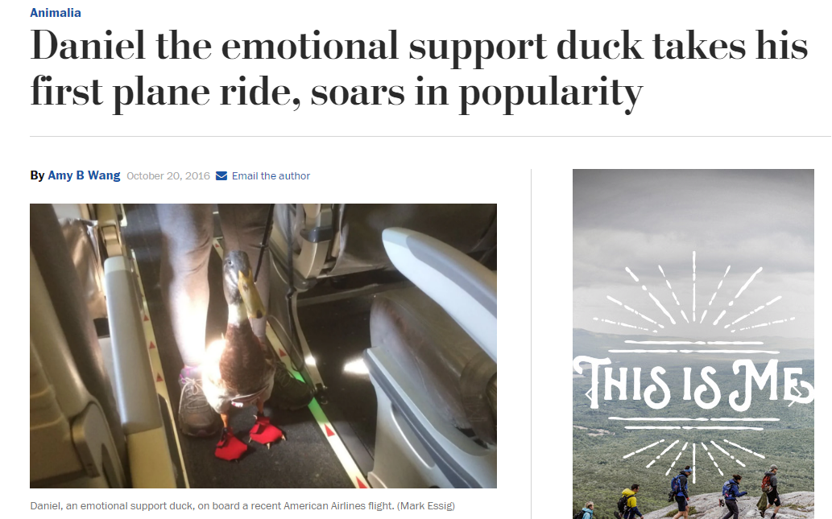

Slide 28
Hypo #2
Sophie is a sophomore at UNC-Charlotte. Sophie was recently prescribed an emotional support animal by her doctor to help control certain symptoms of her depression. Sophie sought permission to have a 2 pound guinea pig attend her Math class for emotional support and to allow the guinea pig to live in her residence hall. Sophie’s roommate transferred to another school at the end of last semester and Sophie plans to live alone in her residence hall room this semester.

Slide 29
Hypo #2
Sophie has requested an answer to her request in three (3) days. Sophie’s mother, who is also an attorney, is cc’d in the email communication to the University.

Slide 30
Hypo #3
Sydney and Sally are sorority sisters at Big U. Sydney is an officer in the sorority and is required to live in the sorority house. Sydney requested that her dog, Peaches, live in the sorority house with her. Peaches is trained to help Sydney manage her panic attacks. Sally complains to Housing and Residence Life that Peaches’ presence in the house gives her headaches and causes her respiratory problems.
Big U concluded that because Sally signed her lease first, Sydney must move out of the sorority house with Peaches or stay in the house without her dog. Sydney immediately sues Big U and seeks a preliminary injunction that would prohibit Big U from taking any further action.

Slide 31
Summary
Service Animal or Service Animal in Training
Dog or miniature horse ONLY
May accompany owner anywhere on campus that is open to the public where the student is allowed to go
University limited in types of questions it may ask student or employee
Owner still subject to UP 704
Emotional Support Animal
No blanket restriction on any specific type of animal
Animal ONLY permitted in the student’s dwelling
University allowed to ask for medical documentation showing a nexus between the disability and emotional assistance provided by the animal
Owner still subject to UP 704

Slide 32
Questions??

Slide 33
